Slide 1
Understanding Energy Usage for Smart Home Device
Kyle Gardner

Slide 2
Presentation Outline
Project Overview
Objectives/Goals
Data Management
Description and Location
Background
Data Analysis and Exploration
Issues Discovered
Recommendation

Slide 3
Data Project Overview
Applicability of data analytics for electrical sub-metering and power management.
Data Description Characteristics
Data Management
2006-2010 (47 months
Location of Data :
Secured on R MySQL Server
Access through R Studio
Electric power consumption from 1 household in FRA
Estimated 2 million measurements
Measurements per date and time
Timeframe :
2006-2010 (47 months)
Submeters:
Sub1: Main Kitchen Appliances
Sub2: Washer/Dryer, Refrigerator
Sub3: Water Heater & AC unit
Power :
KiloWatt Hours
Global active power (not measured in meters)
Data Security
Extract Data
Transform Data
Load Data
Data Analytics
Reporting Dashboard

Slide 4
Objectives/Goals
-Grow business use of sub-meters in housing Market
- Provide homeowners with efficient Smart Homes and increase their understanding and control of their power usage
- Utilize data analytics and visualizations to model patterns of energy usage from electrical sub-meters for residential homes

Slide 5
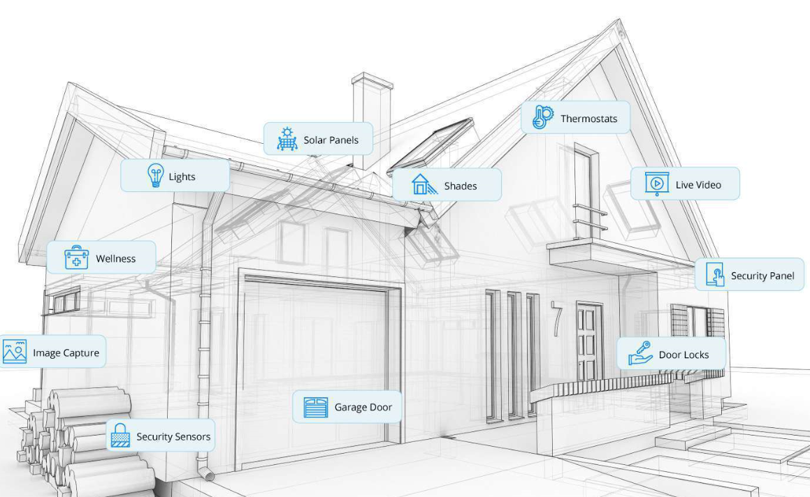
Background: Smart Homes
Homes equipped with lighting, heating, and/or electrical devices that can be controlled remotely
Application of Smart Homes:
Security and Surveillance System
Lighting Schedules
Programmable Thermostat/ Water softener's
Benefits of Smart Homes to Consumers:
Convenience
Control
Savings
Efficiency

Slide 6
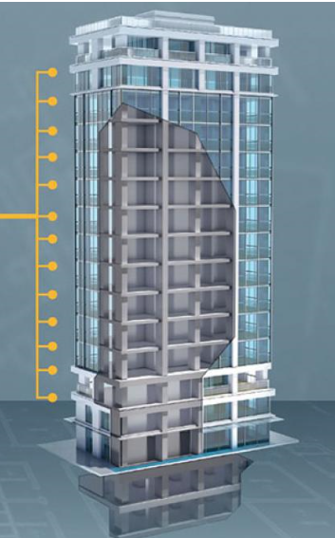
Background: Sub-Meters
Devices that can be used to access, collect, and monitor energy consumption data remotely
What Can be Learned
Measure a specific location or energy load
Categorize of energy from different of sources
Check consistency of power consumption with billing
Identify where energy efficiency opportunities exist
Increase understanding of energy usage

Slide 7
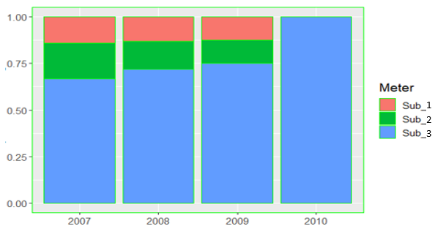
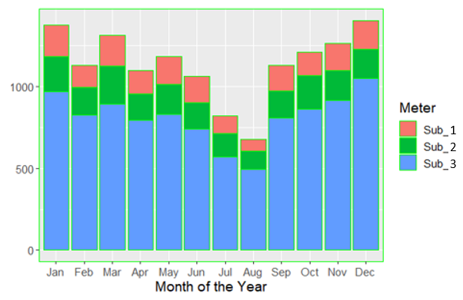
Descriptive Statistics
Power Consumption (POC) (kwh) among Sub-Meters by Year and Month
Meter | Min | 1st | Median | Mean | 3rd | Max
Meter1 | 0.0 | 0.0 | 0.0 | 1.2 | 0.0 | 82.0
Meter2 | 0.0 | 0.0 | 0.0 | 1.3 | 1.0 | 78.0
Meter3 | 0.0 | 0.0 | 1.0 | 6.2 | 17.0 | 31.1
Subm. 1 & 2 had the highest max values
Subm. 3 had the highest power consumption
During yrs, POC rose for Subm. 3 / drop for Subm. 1 & 2
Overall POC drops from Q1 to Q2 /rise from Q3 to Q4

Slide 8
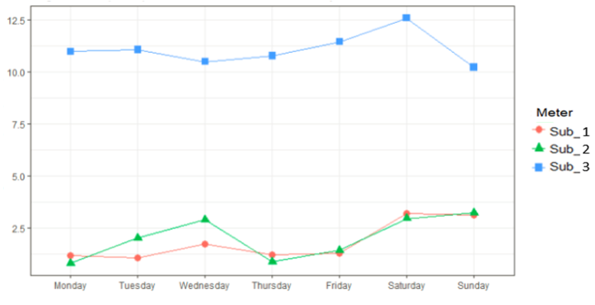
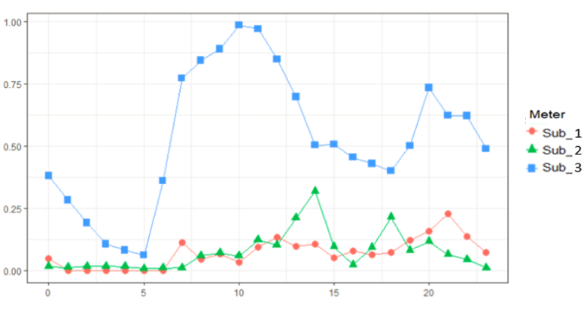

Data Analysis and Exploration
Highest POC was among the month of January
Avg. POC (kwh) by Weekday
Avg. POC (kwh) by Hours
-During the years, Saturday followed by Sunday had the highest avg. POC (over 10.0 kwh)
-POC increased gradually from Wednesday to Saturday for Subm.3
-Variation in POC between Subm.1 & Subm.2 between Mon. to Wed.
-Subm.1 Gradual increase from 3:00pm. Peak observed around 8:00-8:30 pm
-Subm.2 Dormant activity in the am. Peaks observed around 2:00pm and 6:30pm
-Subm.3 Significant POC at 5:00am. Usage high from 7:00am-10:00am

Slide 9



Issues Discovered
Management
Security
-Missing Data Values
- 1.25% of data missing
- Determine if missing due to submeter or human error
- Data is recorded in a different time zone than analysis
-Data Governance access and security concerns
-Convenience of R MySQL
-Interoperability with Tableau
-Long Run times

Slide 10
Recommendations
What to Research
Separate meter 3 into two groups (Water Heater & AC)
Create meters for other electronic or appliances of interests
Check insulation of house during winter and summer for heat lost and accumulation
Check Water Heater &AC settings throughout
Record measurements for all units of time
- Invest in system that improves real-time surveillance of energy used.
Variation in power consumption among different regions
Understand characteristics of household owners
Who are the competitors within the industry
- How can analytics be used to improve power consumption management

Slide 11
Forecast Prediction

Slide 12
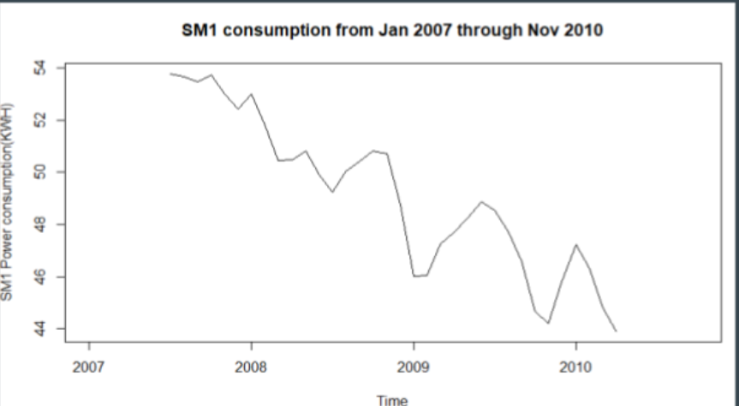
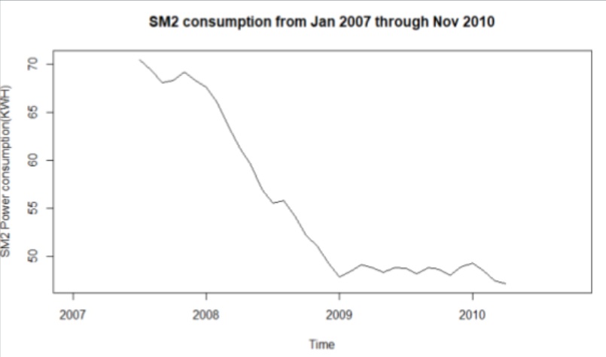
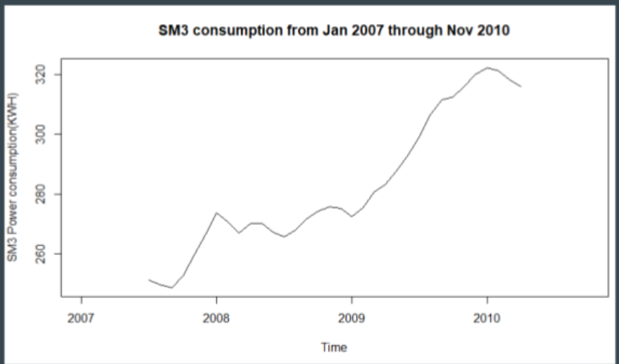
Submeter Trends
- Observed differences in submeters from 2007-2010
- Overall SM1 and SM2 decrease over time
-SM3 gradually increases over time
Utilize data analytics and visualizations to model patterns of energy usage from electrical sub-meters for residential homes

Slide 13
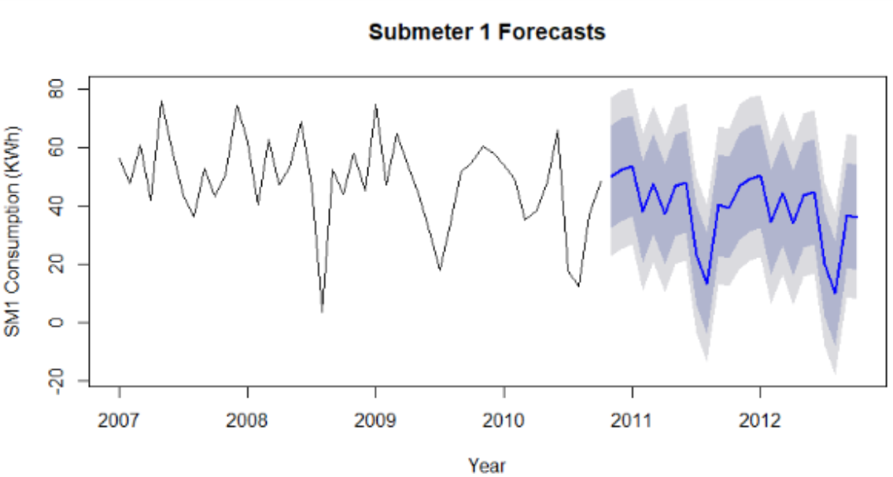
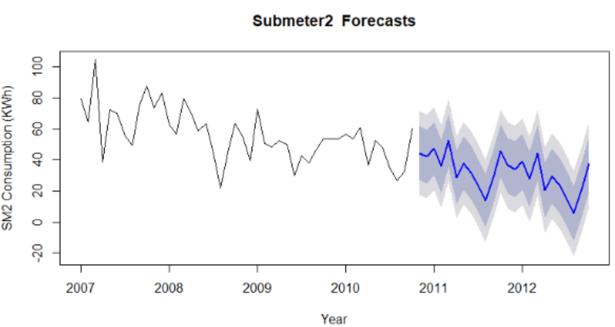
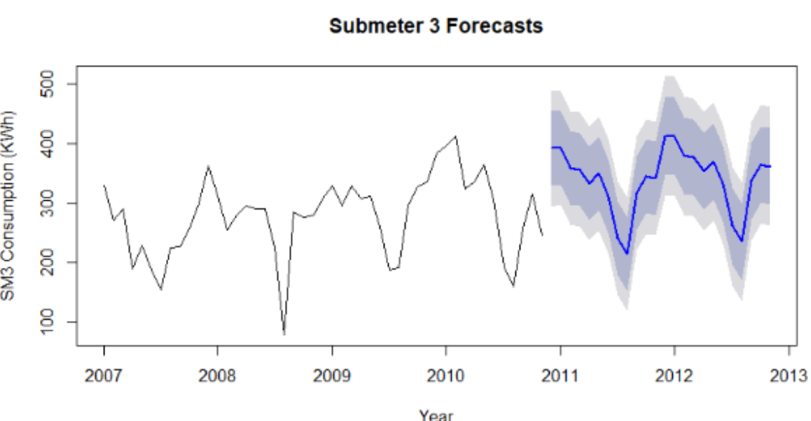
Forecast
-Forecast of total power consumption of
SM1, SM2 and SM3 over the next two
years are consistent with trends
-SM1 and SM2 will gradually decrease
whereas SM3 will increase
-The blue line represents forecast for 2011-2012
-95% prediction interval is represented by light gray area
-80% prediction interval is represented by dark gray area

Slide 14
Conclusion
Submeters are in important and give homeowners better understanding for power consumption
Homeowners using submeters will be able to control and gauge how much energy is being utilized throughout the day and peak hours
Homebuilders should market submeters and explain to homeowners the benefits of submeter control

